Slide 1







STUDENT REGISTRATION
Presented by: Team Cosmos
Koneti Sairam Avinash
Pakalapati Varshini
Nallani Adharsh

Slide 2



PROBLEM STATEMENT
TSPP, in collaboration with several institutions across India, offers a University Academic Program. Only students from these partnered institutions are eligible. However, the registration process was manual and fragmented, creating difficulties in verifying eligibility and managing student data.
2

Slide 3

CHALLENGES
Time consuming
Decentralization
Communication
Delays
3

Slide 4

SOLUTION
A SEAMLESS PEGA BASED REGISTRATION SYSTEM
Centralized, automated Registration workflow
Eligibility validation for students from partnered institutions
Better student experience with seamless registration
4

Slide 5

CONCEPTS COVERED
Case management and Workflow processes
Data Validations
Data Model rules
Correspondence
Declarative Rules
Decision Rules
Service Level Agreements
Data pages
Portals
Questionnaire
5

Slide 6

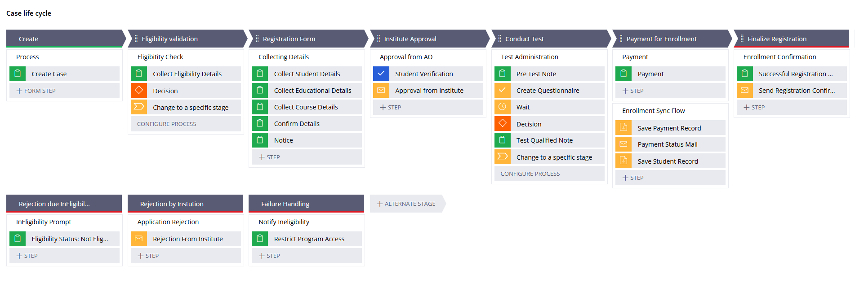
CASE LIFE CYCLE
6

Slide 7


CASE DEMO
7

Slide 8

FUTURE ENHANCEMENTS
Intergrated Chat bot
Duplicate search
More interactive Portals
8

Slide 9

THANK YOU
9

